Slide 1

IoT Device to Detect Anemia
Project ID: 19-129
Members:
M.H.M.Akmal
M.Pravienth
N.Kayanthan
H.S.M.H.Fernando
Supervisor:
Ms. Shashika Lokuliyana

Slide 2
What is Anemia?
Anemia is disease caused by lower iron(Fe) levels in the body
Iron is the main factor to produce hemoglobin in red blood cells(oxygen level reduces)
This disease is mainly caused by;
1. Blood loss
2. Low production of RBC or over destruction of RBC
3. Hereditary

Slide 3
Research Problem
Anemia is not detected an early stage
Lack of portable devices for anemia detection
The World Health Organization has ranked iron-deficiency anemia as the third leading cause of disability adjusted life years lost for females from 15 to 44 years of age.
Blood is extracted for testing

Slide 4
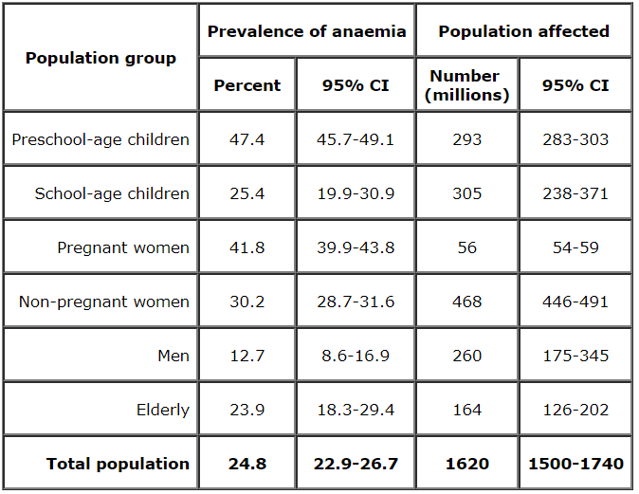
Statistics of Anemia infected Patients
Source: World Health Organization, 2008

Slide 5
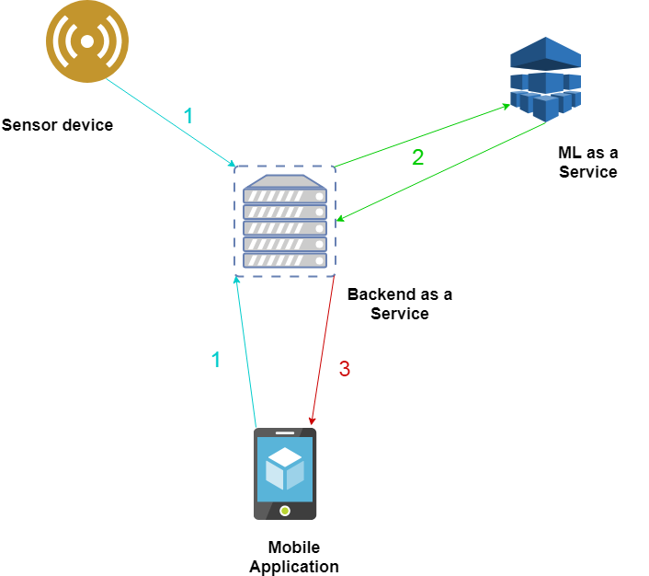
Research Solution
Developing a portable device with anemia detection capabilities

Slide 6
Related Devices Developed
 | Anemia detection Device by Jaime Punter(2015) | Anemia detection device by De Benoist B(2013) | Research product
Portability | ✓ | ✓ | ✓
Non Invasive method | × | ✓ | ✓
Number of symptoms accessed | Blood Test | Hb measurement | Based on 5 symptoms and image of fingertip
Mobile Application | × | × | ✓
IoT implementation | × | × | ✓
Products
Features

Slide 7
Hardware with related components
N.Kayanthan
Member 03

Slide 8
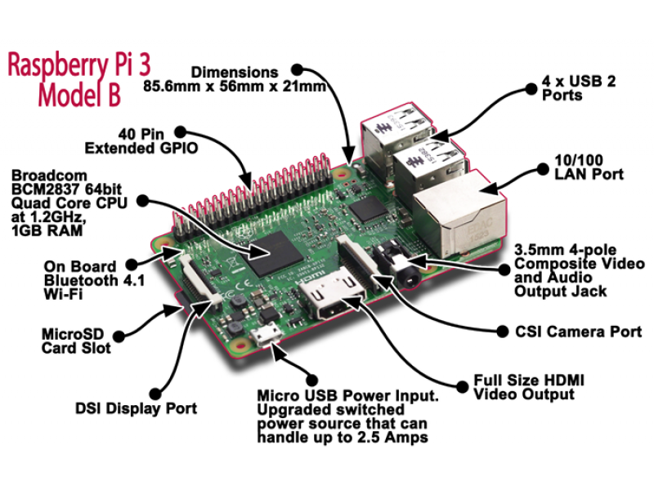
Rasberry Pi3 Model B

Slide 9
Specification of the Raspberry Pi 3 Model B
CPU & Speed | Quad Coretex A53@ 1.2Ghz
RAM | 1GB
GPU | Broadcom 400MHz VideoCore IV
USB Ports | 4 USB 2.0 Port
Storage | Micro-SD
Wifi | 802.11n
Bluetooth | 4.1

Slide 10
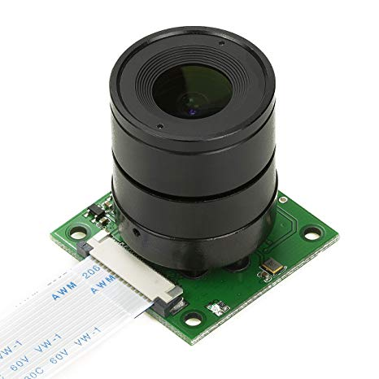
Camera Module
Second Generation Raspberry Pi Camera Module with Fixed Focus Lens
Sony Exmor IMX219 Sensor Capable of 4K30, 1080P60, 720P180, 8MP Still
3280 (H) x 2464 (V) Active Pixel Count
Maximum of 1080P30 and 8MP Stills in Raspberry Pi Board
2A Power Supply Highly Recommended

Slide 11
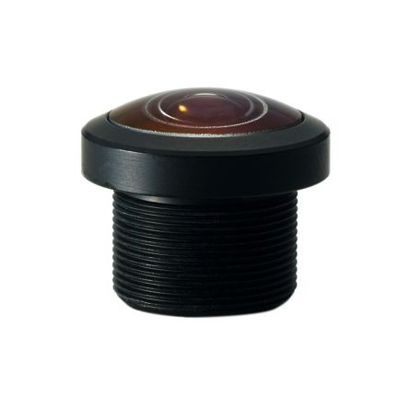
220˚ Wide Angle Fisheye Lens
Aperture F2.1
Field of view – 220˚
6 element lens - 2 glass and 4 plastic
Image circle - 2.80mm diameter
Focal length 0.79mm
Mount type M12
Lens diameter 16mm
IR Filter (RP-L220 )

Slide 12
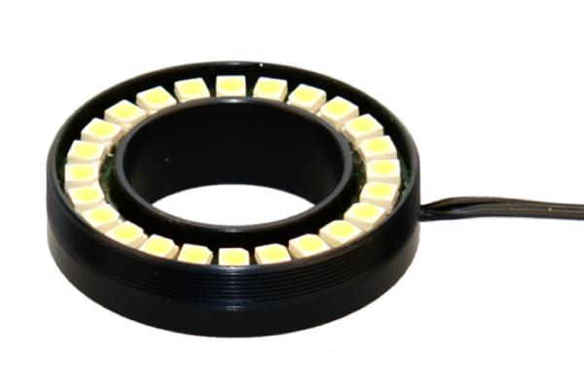
Mini ring LED white light

Slide 13
Image Processing for Anemia Detection
M.H.M.Akmal
Member 01

Slide 14
Objectives
Accurate decision making with image processing
Gaining more knowledge on image processing
Knowledge to process the image and compare it with existing image database
Learning more about the disease and identification

Slide 15
Research Area
Identifying the symptoms and the changes in the finger tip picture of an anemia infected person as well as a normal person using image processing
Implementing image processing in Raspberry pi
Transmitting the result to the server

Slide 16
...Continued
According to a project by Sachin D. Khirade on the topic, “plant detection using image processing” the following steps were followed;
Image Acquisition
Image pre-processing
Image segmentation
Feature extraction in image
Detection and classification of plant disease

Slide 17
Steps in Image processing for anemia detection
Image Acquisition
Image Enhancement
Image Segmentation
Feature Extraction
Image Classification

Slide 18
Building the Mobile Application with IOT Connectivity
M. Pravienth
Member 02

Slide 19
Objectives
Deep Knowledge about the Anemia symptoms and ideas about recovery.
Knowledge to record the data into the database.
The IOT Connection with the server and the mobile application
Knowledge to update and maintain the apps.

Slide 20
Research Area
Deep Interest in the Symptoms of the Anemia
Mobile Application with Android Platform
IoT Platform Connection with the Server and the Mobile Application

Slide 21
Mobile App Design
It calculates with two platforms to calculate the level of disease.
Detect Anemia
Design the Device Output
Questionnaire

Slide 22
Design a Questionnaire
Questionnaire based on the symptoms of the disease. Basically,
  Pale Skin
  Dizziness
  General Fatigue
  Leg Cramps
  Insomnia
  Cold feet and Heads
Difficulty in Concentration
Breathing headache problems
Unusual rapid heartbeat
Tongue Swelling
Feeling faintish and blackout

Slide 23


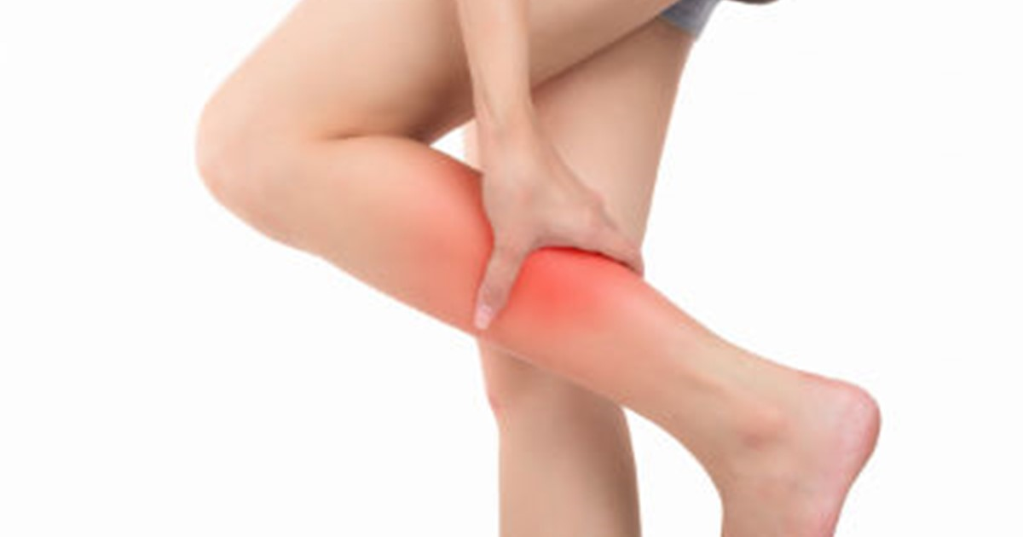
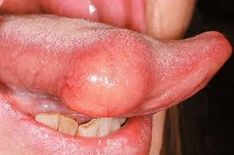
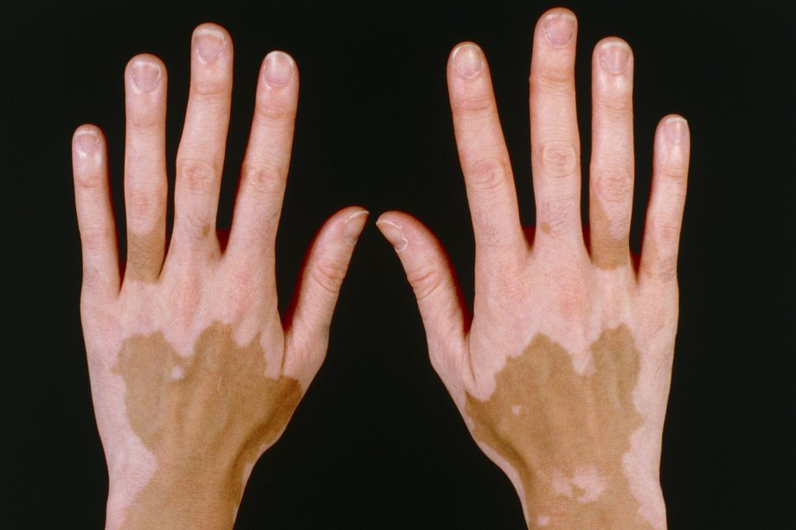
Disease Symptoms Examples
Dizziness
Fatigue
Leg Cramps
Swollen Tongue
Pale Skin

Slide 24


Creation of App
The app can be create within two varieties of mobile platforms.
1. Android Studio
2. React Native
Database ideas
  Local Database
  Realm
  Firebase
  SQLite (C)
  PouchDB

Slide 25
Include in Mobile Application
Login and Register Page
Verification Sheet ( Mail/ Mobile Phone)
Details of the Person
Questionnaire
Final Results Page with Suggestion

Slide 26
IOT Connectivity
After the image processing algorithm and machine learning analysis, the accurate percentage of anemia level displays in the mobile application with the IOT connectivity with the Server.
Save the percentage answers within the database and send it to the server with IOT connection. Registered person details save into the server for their clarification and will update in every testing of the next stages in their following suggestion steps.

Slide 27
Data processing and server configuration
H.S.M.H. Fernando
Member 04

Slide 28
Objectives
Setup back-end of the system providing interfaces to communicate with the device and the mobile application.
Setup and utilize machine learning to determine anemia diagnosis using data gathered from user.
Send the diagnosis results to the user via the mobile application.
Provide data storage and user authentication.

Slide 29
Research Area
Selection of appropriate Machine Learning(ML) algorithm.
Creating the appropriate training data set and making changes to produce the best prediction model.
Determining the best prediction threshold to minimize false positives and false negatives.
Creating APIs for communication between device,server, ML service and mobile app.

Slide 30
MLaaS
AWS machine learning service : Amazon Sagemaker.
Provides visualization tools and wizards that guides through the process of creating ML models and makes it easy to obtain predictions for application using simple APIs.
Near infinite scalability
AWS Free Tier

Slide 31
BaaS
Parse Server is an open source Backend-as-a-Service(BaaS) framework.
Build applications faster with object and file storage,user authentication, push notifications, dashboard and more out of the box with little code required.
Many parse server solutions available in the AWS marketplace as attractive offers.

Slide 32
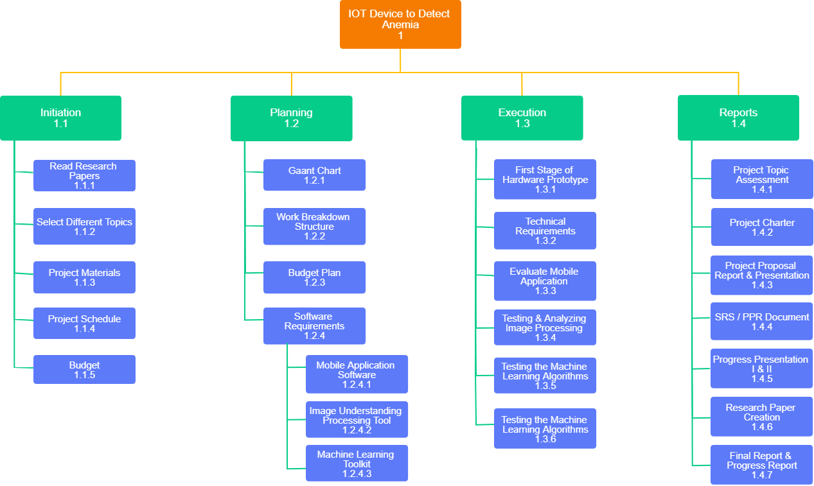
Work Breakdown Structure

Slide 33
Business Scope
According to statistics of UN and Sri Lankan Health authorities there are plenty of anemia infected patients so there exists a profitable market for this type of product.
We can provide this product at hospitals at a reasonable cost

Slide 34
Thank You!!
☺

